Slide 1
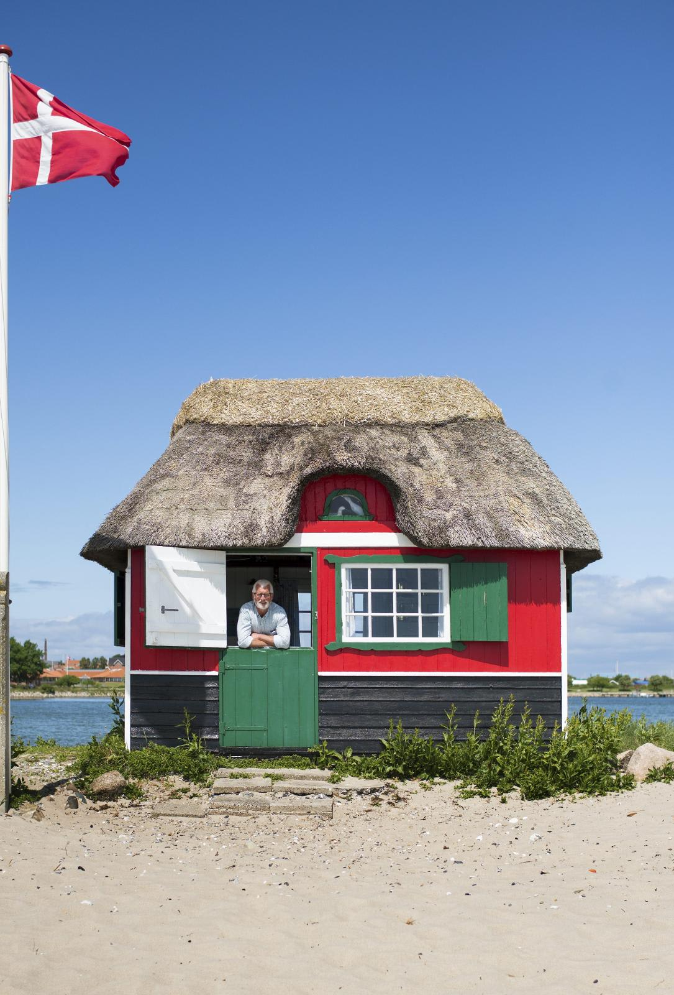
Denmark project
Seminar 1

Slide 2
Status and characteristics of dwelling stock

Slide 3


Model: Sources
Population
Main source: Danmarks Statistik (National statistics office)
Data available from 1769-2026
Available extrapolation until 2070
People per dwelling
Main source: Danmarks Statistik (National statistics office)
Limited coverage: 1986-2026
Secondary source: Jespersen, Mikkelsen, Ørnbjerg (2023) estimating pre-industrial PPD: 5
Assumptions
Constant lifetime of 100 years
Gradual decrease in avg PPD from pre-industrial times until data coverage
PPD only of inhabited buildings, not dormant dwelling stock

Slide 4
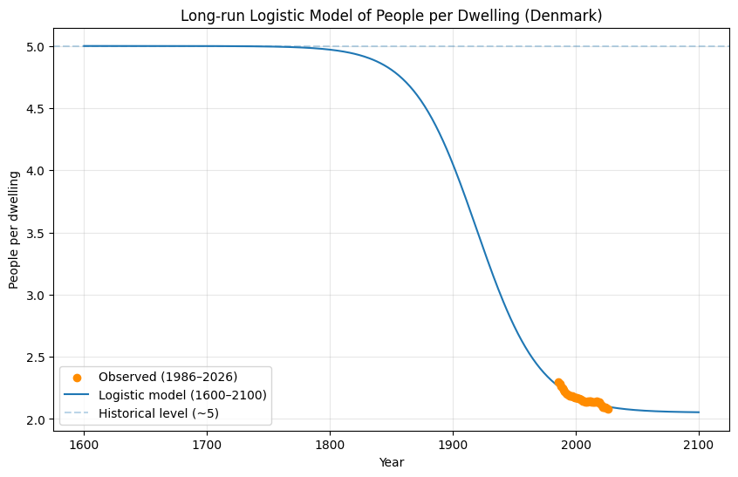
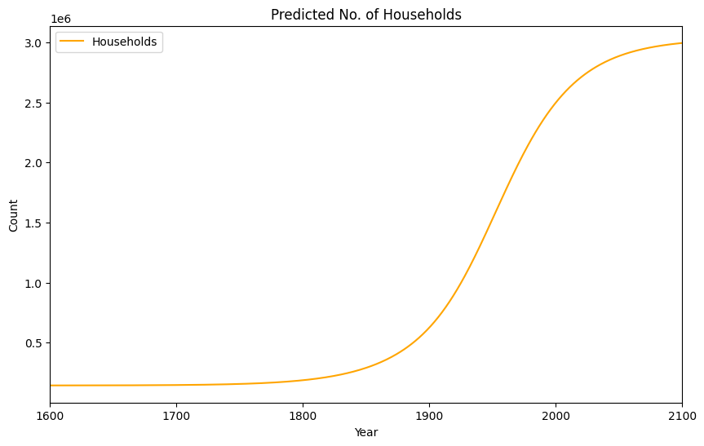
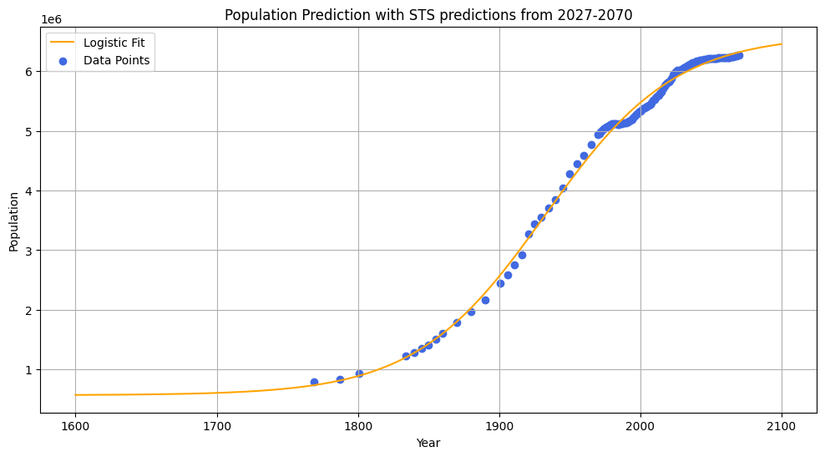
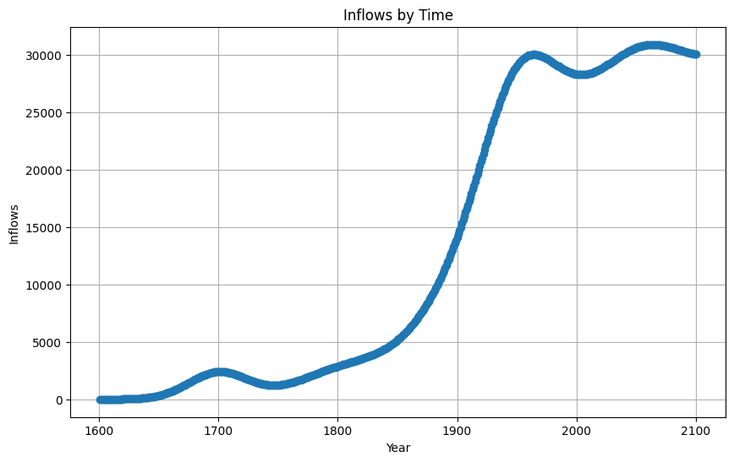
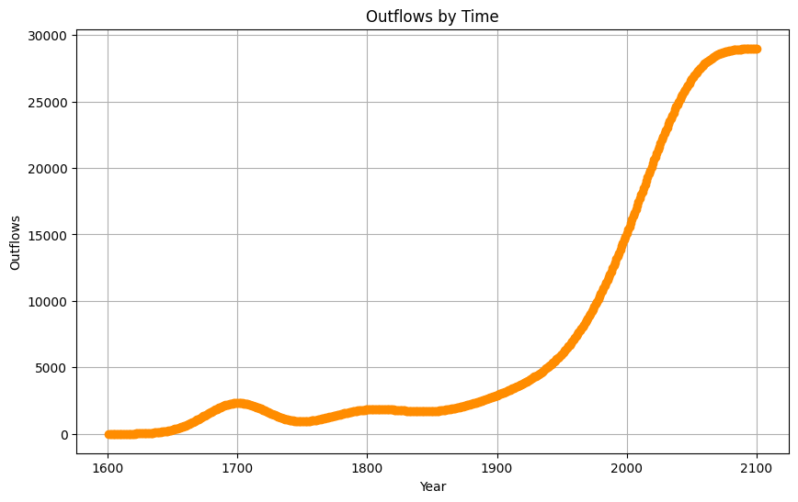
Model: Results

Slide 5
Calibration of drivers

Slide 6
First results

Slide 7
Conclusions and next steps

